Slide 1
The Hidden Geometry of Complex, Network-Driven Contagion Phenomena
Written By Dirk Brockman and Dirk Helbing
Presented by Mitchell T Dennis

Slide 2
Purpose
Change the conventional distance into an effective distance using wavelike, simple reaction-diffusion systems.
Separate the epidemiological parameters from the transport parameters
Dynamics dominated by only a small percentage of transport connections
Approach captures the geographic origins of the disease using temporal snapshots

Slide 3
Metrics and Equations
∂t(S_{n}) = -α(I_{n})S_{n}/N_{n}
∂t(I_{n}) = α(I_{n})(S_{n})/N_{n} – β(I_{n}) n = 1,…,M (1)
∂t(U_{n}) = Σω_{nm}U_{m} – ω_{nm}U_{n} (2)
U_{n} = {S_{n}, I_{n}, R_{n}}
ω_{nm} = F_{nm}/N_{m}
∂tj_{n} = αs_{n}j_{n}σ(j_{n}/ε) – βj_{n} + γΣP_{mn}(j_{m} – j_{n})
∂ts_{n} = αs_{n}j_{n}σ(j_{n}/ε) + γΣP_{mn}(s_{m} – s_{n}) (3)
P_{mn} = F_{mn}F/_{n}
F_{n} = ΣF_{mn}
σ(x) = x^{n}/(1+x^{n}) gain n >> 0
γ = φ/Ω
Ω = ΣN_{n}
P_{mn} = F_{mn}/F_{n}
F_{n} = ΣF_{mn}
d_{mn} = (1 – log(P_{mn}) ≥ 1 (4)
λ(Г) -> Г = {n₁,…,n_{L}}
Dmn = min[λ(Г)] (5)
T_{a} = D_{eff}(P)/v_{eff}(α,R₀, γ, ε) (6)
T_{a}(n|k)/T_{a}(m|k) = D_{eff}(n|k)/D_{eff}(m|k) (*)

Slide 4
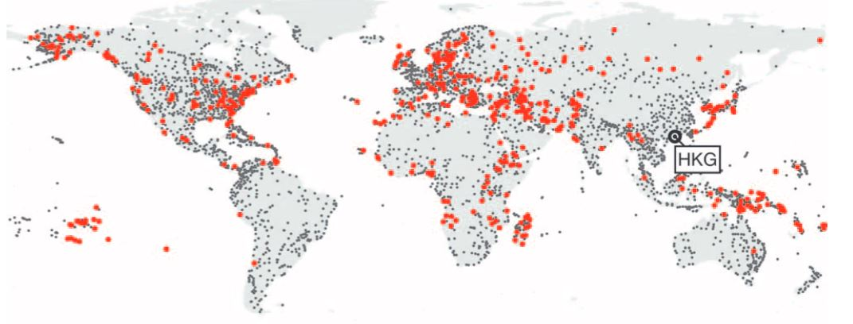
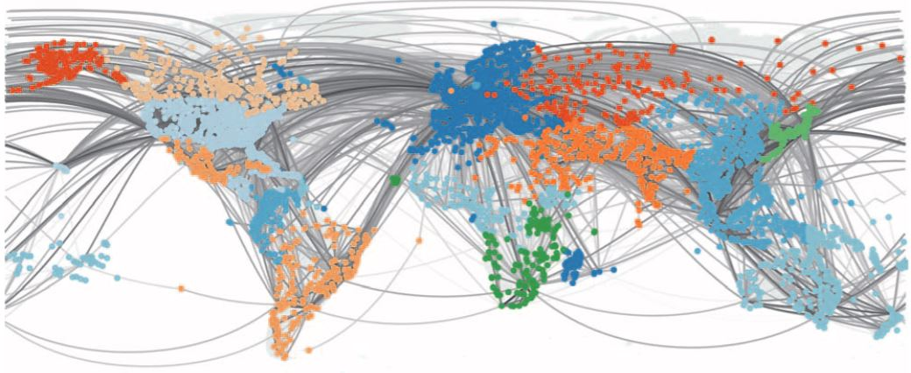
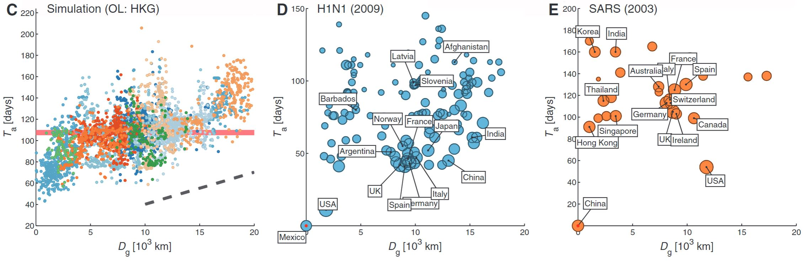
Hong Kong Outbreak

Slide 5
Consequences From Hong Kong (1) & (2)
Only in the early stages does j_{n}(t) correlate with distance from the outbreak location (OL)
At intermediate stages the multiscale structure induces spatial decoherence of the spreading
Despite global connectivity, the spatiotemporal patterns do not converge to the same pattern.

Slide 6
Probable Paths and Distance (4) & (5)
Derived from the connectivity matrix P. (Think of a weak resistor in a set of strong resistors in parallel).
Effective Distance is analogous to a small fraction of traffic is the same as a large distance.

Slide 7
A Hidden Geometry (3)
Where are the advantages?
Effective Distances reveals coherent wave fronts vs spatiotemporal patterns
Robust against variations in epidemic parameters and true for any OL
Contagion dominated by probably paths
Determined by mobility components not disease specific epidemiological rate parameters.

Slide 8
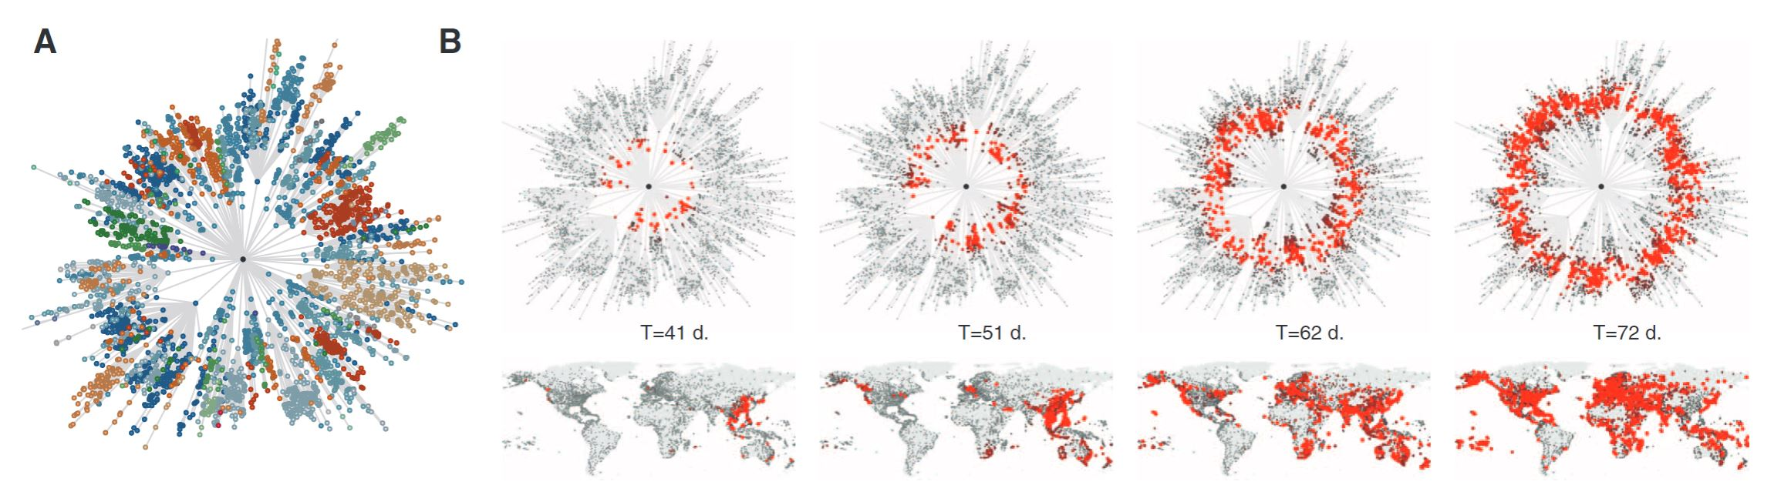
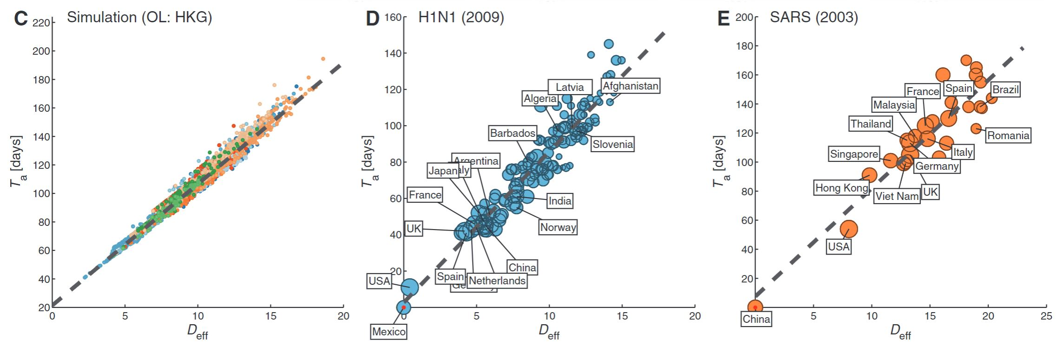
Hong Kong W/Effective Distance

Slide 9
Independence of Epidemic parameters (6)
Arrival time computed from spreading speed and effective distance
Key problem: Disease parameter unknown
But Speed is a global property, irrespective of origin and mobility network
Investigate how effective speed depends on rate parameters

Slide 10
Origin Reconstruction From E.D.
How to determine origin of outbreak
Effective distance perspective includes concentricity.
Most concentric node is the outbreak location.
Further Study: introducing a measure for concentricity
A shortest path tree will yield the outbreak location if calculated for every 4069 nodes (requires knowledge of entire outbreak)

Slide 11
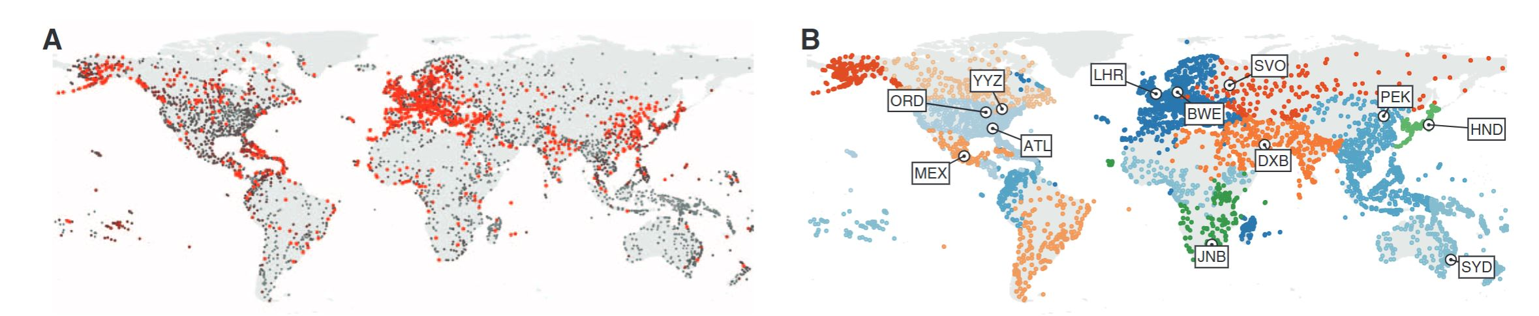
Origin Reconstruction
Use surface roughness characterization for nodes above a threshold in a small time window

Slide 12
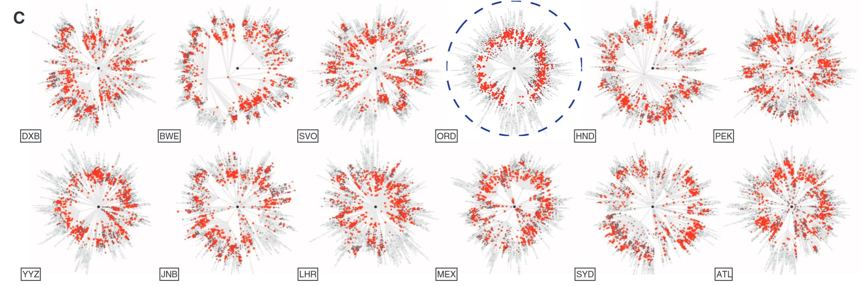
Origin Reconstruction from E.D.

Slide 13
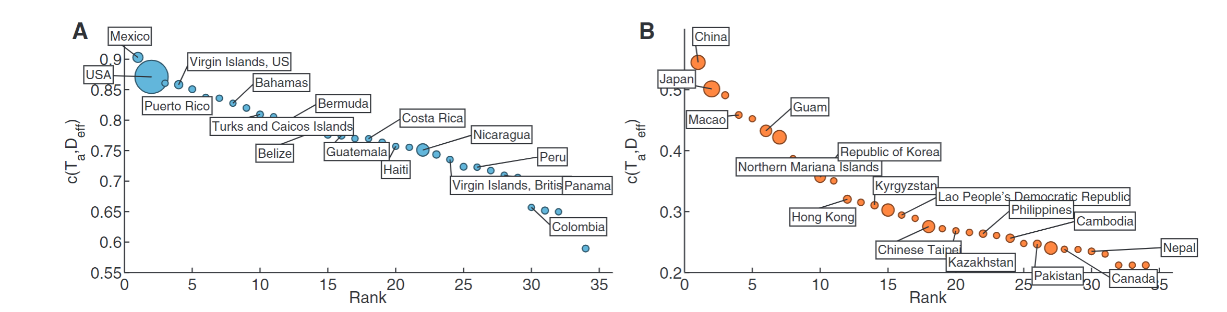
Origin Reconstruction from E.D.

Slide 14
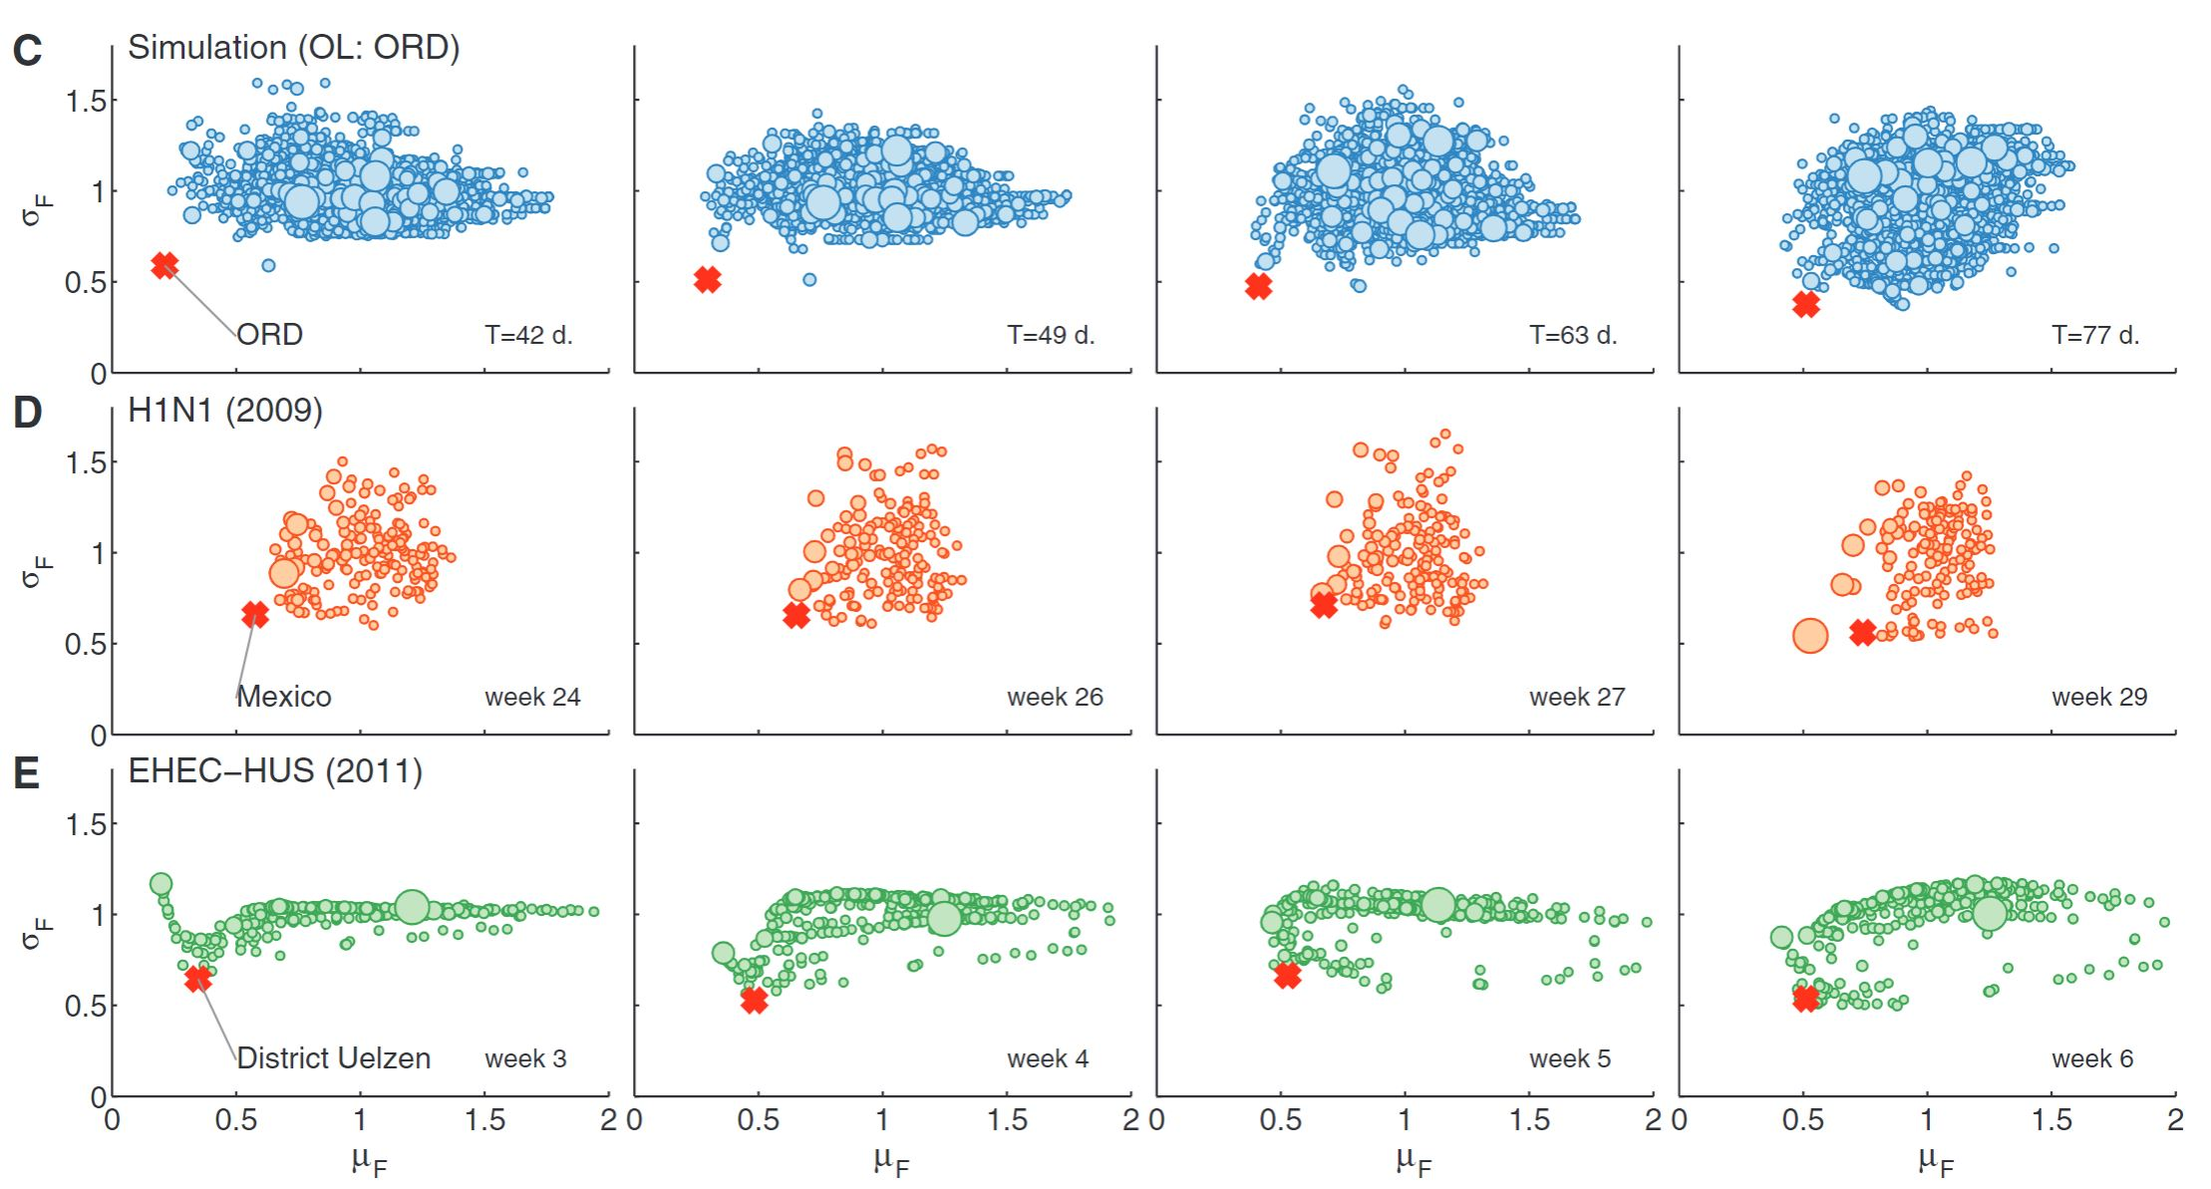
Origigin Reconstruction from E.D.
Mean and Std. Dev. of E.D.
True O.L. apart from cloud

Slide 15
Challenges
Data are subject to inaccuracies and incompleteness
Fluctuations may play a more significant role.
Response and mitigation measures not included
Does not completely identify the O.L. in cases of food transport vs air (graphs made with air transport networks)

